Slide 1
CSA0695-DESIGN AND ANALYSIS OF ALGORITHMS FOR OPEN ADDRESSING TECHNIQUE
GREEDY METHODS
SIMATS -SAVEETHA SCHOOL OF ENGINEERING
CHENNAI-602105
Project By: Guided By:
G.Shyamala DR.R.DHANALAKSHMI
(192211641)
CSE

Slide 2




Problem Statement
Given an array usageLimits of length n, the goal is to create the maximum possible number of groups using numbers from 0 to n - 1. Each group must contain distinct numbers, with the length of each group (except the first) strictly greater than the previous one. Additionally, each number can be used no more than its corresponding usage limit across all groups.
Numbers
The elements used to form groups.
Usage Limits
Constraints on the number of times a number can be used.
Groups
Sets of distinct numbers formed according to the constraints.

Slide 3




Abstract
This paper presents a solution to the problem of maximizing the number of groups that can be formed from a set of numbers with usage limits. The solution utilizes a greedy approach to create the initial groups and then applies dynamic programming to optimize the group count. This approach effectively balances maximizing group formation with adhering to the constraints of distinct numbers and increasing lengths.
Greedy Approach
Dynamic Programming
Constraints
Initial group creation prioritizing maximum usage.
Optimization of the group count for maximum efficiency.
Distinct numbers and increasing lengths govern group formation.

Slide 4
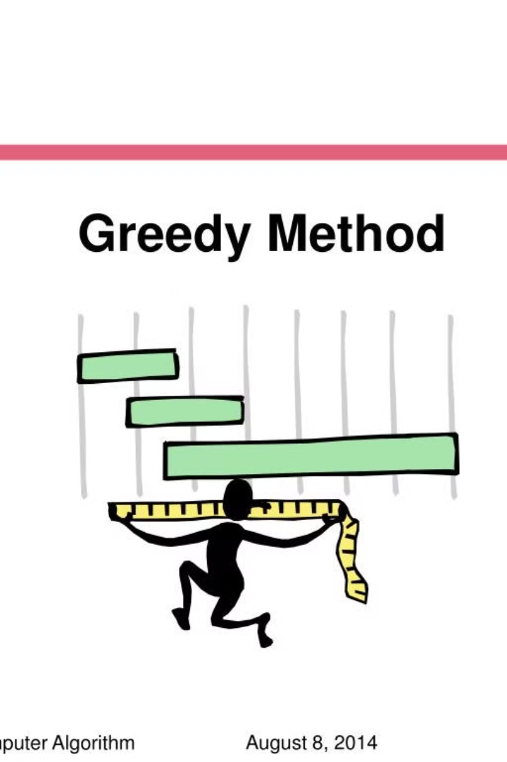
Maximizing Groups with Increasing Length
This presentation delves into the problem of maximizing the number of groups formed from a set of numbers, given usage limits for each number, while adhering to specific constraints regarding group length.

Slide 5

Constraints and Requirements
The challenge involves creating groups using numbers from 0 to n - 1, ensuring each number is used within its usage limit. Groups must consist of distinct numbers, and except for the first group, all subsequent groups must have strictly increasing lengths.
1
Distinct Numbers
2
Increasing Lengths
Each group can only contain unique numbers, preventing duplication.
Starting from the second group, each group must have a larger number of elements than the previous one.
3
Usage Limits
The number of times each number can be used across all groups is constrained by the usageLimits array.

Slide 6
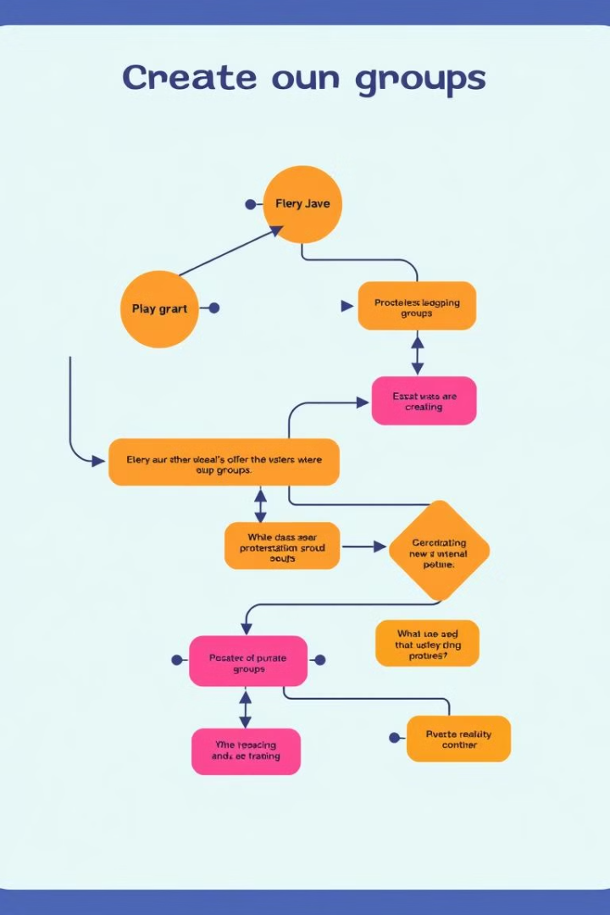
Approach to Creating Groups
A greedy approach can be adopted to maximize the number of groups. Start by creating the largest possible first group, maximizing the usage of numbers within their limits, while ensuring the group's length is within the constraints. Subsequent groups are then formed by increasing the length by one, again prioritizing the maximum usage of numbers within their limits.
1
Create First Group
Form the first group by maximizing the usage of each number, adhering to their usage limits and the group length constraint.
2
Increase Length
Increment the group length for each subsequent group, maintaining the increasing length requirement.
3
Maximize Usage
Within the constraints of the usage limits and group length, maximize the number of elements used in each group.

Slide 7
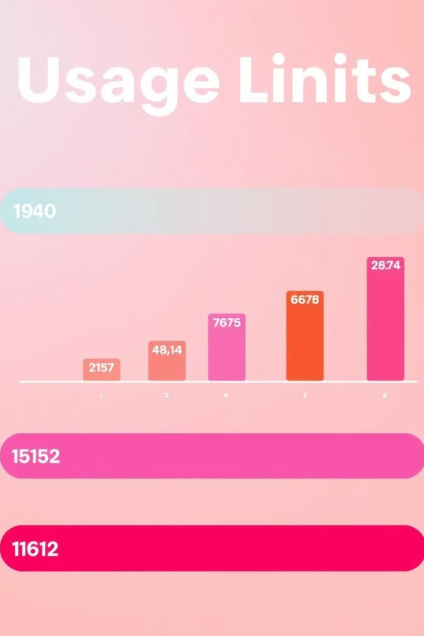
Limiting Usage of Each Number
Each number in the input array has a usage limit, dictating the maximum number of times it can be used across all groups. This constraint must be respected while forming the groups, ensuring no number exceeds its usage limit.
Number
Usage Limit
0
2
1
3
2
1

Slide 8
Optimizing the Number of Groups
To optimize the number of groups, a dynamic programming approach can be used. The approach involves building a table where each cell represents a specific group size and its corresponding maximum number of groups achievable. By iterating through the table, using information from previous cells, the optimal number of groups can be determined.
Dynamic Programming
Optimization
Table
A tabular approach to solve complex problems by breaking them into smaller overlapping subproblems.
The algorithm aims to determine the maximum number of groups that can be formed, given the constraints.
Each cell in the table stores the maximum number of groups achievable for a specific group size.

Slide 9


Future Scope
Further exploration could involve investigating the applicability of this approach to more complex scenarios. Exploring alternative optimization algorithms, such as simulated annealing or genetic algorithms, could offer insights into finding even more optimal solutions.
Advanced Algorithms
Complex Scenarios
Investigating other optimization algorithms to enhance the solution.
Exploring the application of the solution in more intricate settings.

Slide 10

Conclusion and Key Takeaways
The presented approach enables the maximization of groups formed while respecting the usage limits and increasing length constraints. Dynamic programming provides an efficient solution for optimization, while the greedy approach ensures the formation of the largest possible groups.
Dynamic Programming
Greedy Approach
Effective for optimizing the number of groups achievable.
Facilitates the creation of the largest possible groups.
Constraints
Usage limits and increasing lengths play crucial roles in group formation.

Slide 11
THANKYOU

